Slide 1

Multilingual Fake News Detection
Guide:
Mrs.N.Mounika
Batch:260
221FA04462 - Shaik Rehana Sulthana
221FA04686 – G.Keerthi Lakshmi

Slide 2
INTRODUCTION
The growth of digital media has made news easily accessible, but it has also increased the spread of fake news, which can mislead people and cause social and political harm. Fake news spreads rapidly on online platforms, especially social media.
Most fake news detection systems focus only on English, making them ineffective in multilingual environments. This project proposes a Multilingual Fake News Detection System using NLP and transformer-based models to identify fake and real news across multiple languages.

Slide 3
PROBLEM STATEMENT:
Fake news spreads widely in multiple languages, but existing detection systems are mostly language-specific. There is a need for an automated system that can accurately detect fake news across different languages using a single model.
The goal of this project is to develop a multilingual fake news detection system that handles linguistic variations while maintaining reliable performance.

Slide 4
Dataset Description
Data Set: Multilingual Fake News Detection
Source: Kaggle
Split:
Training data: 75%
Testing data: 25%

Slide 5
Identification of Tools / Equipment / Training Needs
Tools / Software
Programming Language: Python
Development Environment:Google Colab
Libraries Used:
NumPy, Pandas – data handling
Scikit-learn – preprocessing and evaluation
PyTorch / TensorFlow – deep learning framework
Transformers – mBERT, RoBERTa models
Matplotlib – result visualization
Hardware / Equipment
Laptop / Desktop Computer
Minimum 8 GB RAM (recommended for smooth execution)
GPU support (Google Colab / CUDA) for faster transformer training

Slide 6
BASIC MODEL USED
To establish a baseline, traditional machine learning models are used:
Naive Bayes
Logistic Regression
Support Vector Machine (SVM)
Convolutional Neural Network (CNN)
Long Short-Term Memory (LSTM)
Bidirectional LSTM (Bi-LSTM)
Features:
TF-IDF (Term Frequency–Inverse Document Frequency)
Bag of Words (BoW)

Slide 7
PROPOSED MODEL
To improve accuracy and handle multilingual text effectively, advanced transformer-based models are proposed:
XLM-RoBERTa (XLM-R) Large
Ensenble Model(XLM-R Small+ mBERT+ Bi-LSTM+ and TF-IDF )
Advantages:
Supports multiple languages
Captures contextual and semantic meaning
Works well for low-resource languages
Single model for all languages

Slide 8
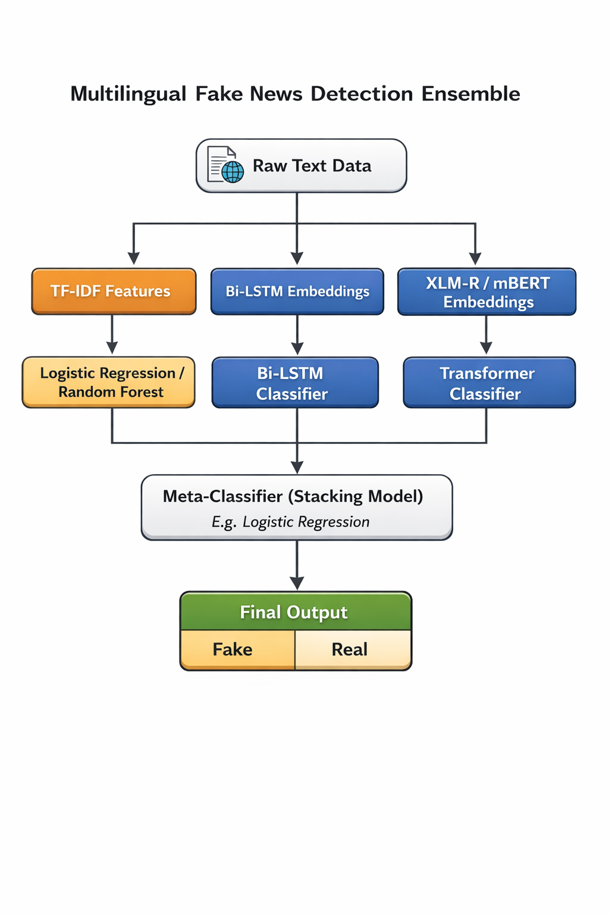
Proposed Model Architecture

Slide 9
Methodology
Dataset Collection
Use the provided multilingual training and testing datasets
Data Preprocessing
Remove noise (URLs, punctuation, special characters)
Tokenize text using multilingual tokenizer
Feature Extraction
TF-IDF for baseline models
Transformer embeddings for proposed models
Model Training
Train baseline ML models
Fine-tune multilingual transformer models
Evaluation
Accuracy, Precision, Recall, F1-Score

Slide 10
Literature Survey
Title | Methodology & Models Used | Performance / Accuracy | Key Improvements / Contributions | Identified Limitations
TamilNews Inspector: A Multilingual Fake News Detection Framework Using Sentence Embeddings and Ensemble Learning | Sentence Transformer (distiluse-base-multilingual-v1) + XGBoost | 97.3% classification accuracy | Modular pipeline for Tamil/English; uses language-agnostic embeddings | No Explainable AI (XAI) integration; currently restricted to two languages
Fake News Detection Model Based on RoBERTa and XGBoost | RoBERTa (semantic extraction) + XGBoost classifier | 97% average F1-score on ISOT dataset | Lightweight decoupled strategy that separates feature extraction from decision-making | Lacks multimodal features; needs evaluation on larger cross-language datasets
A Multi-Linguistic Fake news detector on Hindi, Marathi and Telugu | Fine-tuned mBERT (Multilingual BERT) | 96% F1-score across Indic languages | Leverages Transfer Learning from English to low-resource Indic languages | Performance drops significantly when zero-shot testing across dissimilar languages
FaND-X: Fake News Detection using Transformer-based Multilingual Masked Language Model | XLM-RoBERTa, Bangla-BERT, and mBERT | 98% F1-score achieved with XLM-R | Framework for Bengali news; developed the Bengali Fake News Corpus (BFNC) | Sarcasm and complex morphology in Bengali remain highly challenging
CIFNet: A Cognitive-Inspired Fake News Detection Network for Urdu and English Multimodal Content | BERT, UrduBERT, and ResNet-50 + Cross-modal Transformer | 97% (English) and 93% (Urdu) accuracy | Multimodal (Text + Image) fusion inspired by human cognitive principles | Computationally heavy fusion layers; high dependency on OCR and image quality
BSM-DND: Bias and Sensitivity-Aware Multilingual Deepfake News Detection Using Bloom Filters and Recurrent Feature Elimination | Bloom Filters + RF + SVM + Recursive Feature Elimination | 99.91% (English), 98% (Italian/Bengali) | Three-class classification (Authentic/Dangerous); uses Bloom filters for speed | Increased space complexity for storing large categorized sensitive keyword lists
Interpretable BERT and RoBERTa based Fake News Detection using LIME | BERT and RoBERTa + LIME (Explainability) | 99.20% accuracy with fine-tuned RoBERTa | Addresses the "black-box" problem by providing word-level interpretability | Focused on static benchmarks; may not fully capture dynamic real-world campaigns
Generalized Multilingual AI-Powered System for Detecting Fake News in India: A Comparative Analysis of Machine Learning Algorithms | Logistic Regression, NB, and AdaBoost | 99% accuracy using Logistic Regression | Includes web scraping for URL headers and automated language detection | Initial dataset size was small; required cross-dataset validation for consistency
AMUSED: A Multilingual Urdu-English Stance and Fake News Detection Corpus | m-BERT (Stance) and RoBERTa (Fake News) | 79% F1-score for fake news detection | First Urdu-English event-based corpus including social context (comments/likes) | Limited to 3 social platforms; needs multimodal expansion
Hybrid Semantic and Contextual Analysis for Multilingual Fake News Detection Using Deep Learning | BERT (Hindi), MURIL (Tamil), Word2Vec (English) + LSTM | 97% (Hindi), 93% (English), 84% (Tamil) | Combines standard extraction (TF-IDF) with language-specific embeddings | Lower performance in Tamil due to its high linguistic complexity
Cloud-Integrated Fake News Detection in European Portuguese: A Multilingual XGBoost Model Optimized for Accuracy | Optimized XGBoost (Jellyfish Algorithm) | Peak precision of 97.91% | Nature-inspired optimization for XGBoost weight selection in Portuguese | Dependent on specific Portuguese stop-word removal and preprocessing

Slide 11
Hybrid Semantic and Contextual Analysis for Multilingual Fake News Detection Using Deep Learning | BERT (Hindi), MURIL (Tamil), Word2Vec (English) + LSTM | 97% (Hindi), 93% (English), 84% (Tamil) | Combines standard extraction (TF-IDF) with language-specific embeddings | Lower performance in Tamil due to its high linguistic complexity
Cloud-Integrated Fake News Detection in European Portuguese: A Multilingual XGBoost Model Optimized for Accuracy | Optimized XGBoost (Jellyfish Algorithm) | Peak precision of 97.91% | Nature-inspired optimization for XGBoost weight selection in Portuguese | Dependent on specific Portuguese stop-word removal and preprocessing
Optimising the Detection of Fake News in Multilingual Exposition using Machine Learning Techniques | Random Forest, SVM, and Chaos-based initialization | 99.95% accuracy using Random Forest | Systematically compares vectorization methods; uses Chaos Theory for optimization | High risk of overfitting to the specific static datasets utilized
Enhancing Misinformation Detection in Arabic and English: A Hybrid Study Using Machine Learning Classifiers and Deep Neural Networks | AraBERT and hybrid CNN-LSTM | 99.6% accuracy for Arabic news | Specialized pipeline for Arabic diacritics and root-based morphology | High GPU requirements; Arabic "out-of-vocabulary" words remain an issue
Multilingual Misinformation Detection: Deep Learning Approaches for News Authenticity Assessment | BiLSTM and hybrid 1DCNN-BiLSTM | 92.36% accuracy for the hybrid model | Uses spatial (CNN) and temporal (BiLSTM) features for news authenticity | Resource-constrained for lower-resource Indian regional languages
Unveiling the Source: Differentiating Human and Machine-Generated Texts in a Multilingual Setting | MDeBERTA and Stylometric Neural Network | 0.8956 Macro F1-score | Bagging ensemble that uses 26 language-agnostic stylometric features | Difficulty handling short text snippets and nuanced low-resource features
Deep Learning Approach to COVID-19 Misinformation on Social Media with Multimodal and Multilingual Deep COVID-Fake Sense Model | BERT + Bi-LSTM (text) and GNN (visual) | 82.93% accuracy | Fuses textual and visual graph features specifically for COVID-19 data | Susceptible to training data bias; high computational requirements
Deciphering Deception: Unmasking Fake News in Multilingual Contexts | Comparative Literature Assessment | N/A (Review Paper) | Identifies the "Multilingual-Fake Model" as the most effective gap-filler | Notes a critical lack of language-specific detectors for non-English users

Slide 12
CONCLUSION
This project presents an effective approach to detecting fake news in a multilingual environment using NLP and deep learning techniques. By combining multiple datasets and applying transformer-based models, the proposed system achieves better generalization across languages compared to traditional methods. The solution is scalable, language-independent, and suitable for real-world applications such as social media monitoring and news verification.

